Slide 1

Spotify Listening Habits Analysis
Plus Exploration of Song Popularity
by Rafael Ignacio González Chong & Zhaowen Fan

Slide 2

01
Project Definition
02
Cleaning the data
03
Finding the most popular artist and album of each month
Content
04
Finding the underlying listening habits

Slide 3
01
Project Definition

Slide 4

About
This dataset contains a detailed Spotify listening history of a user. Each record captures information about a specific track played on Spotify, including metadata about the track, playback behavior, and the user's interaction with the platform. It spans multiple years and provides insights into user behavior, track preferences, and session dynamics.
Objectives
Investigate how user listening habits and song popularity vary depending on the shuffle settingand identify factors that influence whether a song is skipped or not.
We aim to learn which songs or artists are associated with higher engagement

Slide 5

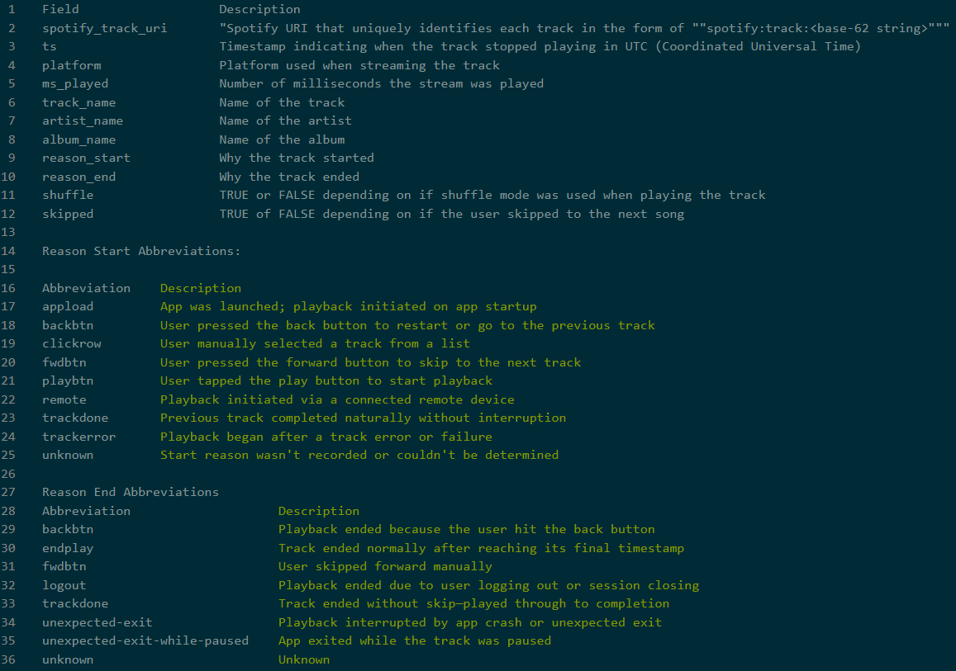
Dictionary Description

Slide 6
02
Cleaning the data

Slide 7
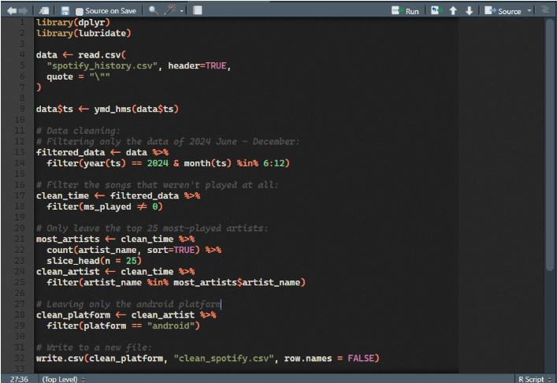
Data Cleaning
We used R for the data cleaning, the process are below:

Slide 8
Finding the most popular artist and album of each month
03

Slide 9
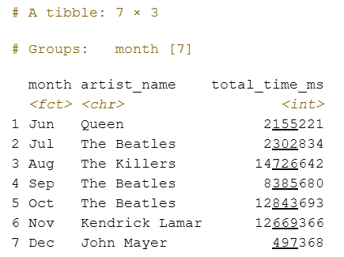
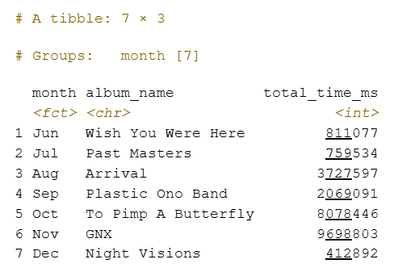


Finding the most popular artist and album of each month
Top Artists
Top Albums

Slide 10
04
Finding the underlying listening habits

Slide 11
Finding the underlying listening habits
We analysed the pattern based on the relationships between reason start and skipped, reason end and skipped, and shuffle and skipped. To calculate the skip rate, the dataset was grouped by the combinations of reason_start and reason_end, and the mean of the skipped variable within each group was computed to represent the proportion of skipped tracks for each reason pair.

Slide 12
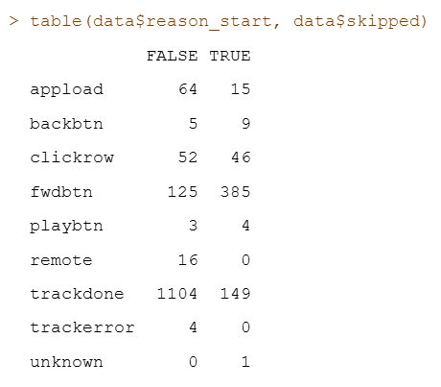
Reason Start & Skipped
- Certain start reasons (like "trackdone" or "forwardbtn") tend to have lower skip rates, implying intentional listening.
- Others, like "appload" or "clickrow", often show higher skip rates, suggesting passive starts or exploratory clicks.

Slide 13
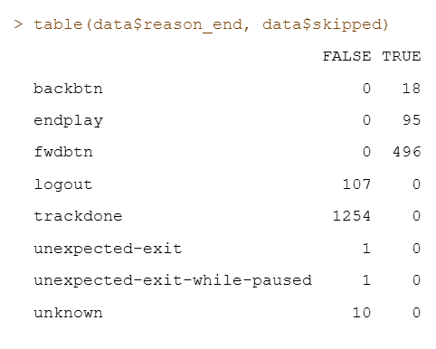
Reason End & Skipped
- Reasons like "endplay" or "trackdone" are typically not associated with skipping — they imply full consumption.
- "backbtn", "logout", or "fwdbtn" often correlate with higher skip rates, especially when the track is interrupted.

Slide 14
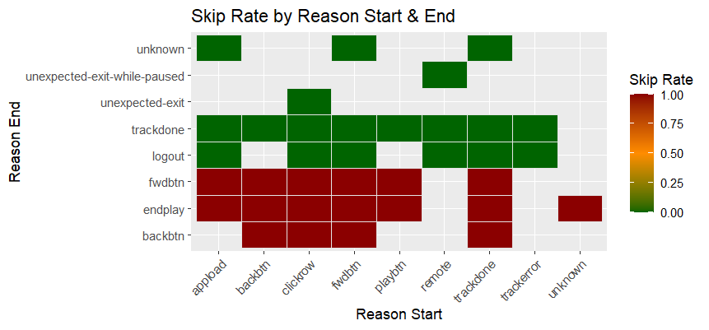
Heatmap for Reason Start & End & Skipped

Slide 15
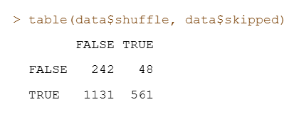
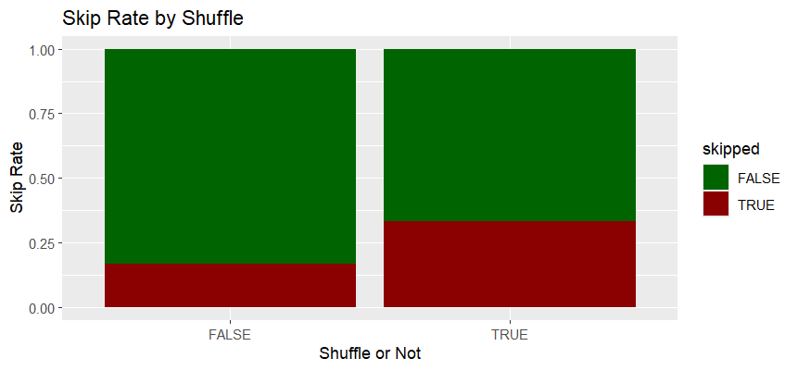
Shuffle & Skipped
- On average, users tend to skip more often when shuffle is enabled.
- This could reflect that shuffled tracks don’t always match the listener’s momentary preference.
passive starts or exploratory clicks.

Slide 16
Conclusion
05

Slide 17
Conclusion & Summary
This project explored how reason_start, reason_end, and shuffle influence track skipping behavior. By grouping the dataset by start–end reason pairs and calculating mean skip rates, we identified patterns in user intent. Tracks started via "trackdone" or "forwardbtn" had lower skip rates, reflecting deliberate listening, while "appload" and "clickrow" showed higher skip rates, suggesting passive or exploratory behavior. End reasons like "endplay" and "trackdone" were linked to full consumption, whereas "backbtn", "logout", and "fwdbtn" correlated with interruptions and higher skip rates. Shuffle mode consistently increased skip rates, likely due to mismatched track preferences. These results indicate that skipping is shaped by user context and interaction patterns, offering insights for improving recommendation algorithms and playback design.

Slide 18
THANKS

